Slide 1
Lecture 6
Computer Simulation
Prof. Dr.Abbas H. Hassin Alasadi
Computer Information System
Computer Science and Information Technology
Basrah University
Email: abbashh2002@gmail.com
2019-2020

Slide 2
Queuing Models
In a typical queuing model customers (people, machines, requests, etc.) arrive from time to time and join a queue (waiting line), are eventually attended by a server (person, machine, computer, etc.), and finally leave the system.
Queuing models, whether solved mathematically –which is only possible for relatively simple models– or analyzed through simulation, provide the analyst with a powerful tool for designing and evaluating the performance of queuing systems.

Slide 3
Queuing Models
Queuing models have found widespread use in the analysis of service facilities, production and material-handling systems, computer and communications systems, and many other situations where congestion (اِزْدِحام) or competition for scarce resources can occur.
CMS (Content management system) techniques may be used to generate a number of artificial histories of a complex system and to obtain estimates of desired system-performance measures.

Slide 4
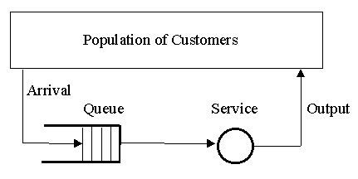
Queuing Models
The elements of a single queue queuing system:

Slide 5
Queuing Models Elements
Population of Customers can be considered either limited (closed systems) or unlimited (open systems). Unlimited population represents a theoretical model of systems with a large number of possible customers (a bank on a busy street, a motorway petrol station).
It is necessary to take the term "customer" very generally. Customers may be people, machines of various nature, computer processes, telephone calls, etc.

Slide 6
Queuing Models Elements
Arrival defines the way customers enter the system. Mostly the arrivals are random with random intervals between two adjacent arrivals. Typically the arrival is described by a random distribution of intervals also called Arrival Pattern.
Queue represents a certain number of customers waiting for service (of course the queue may be empty). Typically the customer being served is considered not to be in the queue.

Slide 7
Queuing Models Elements
There are two important properties of a queue: Maximum Size and Queuing Discipline.
Maximum Queue Size (also called System capacity) is the maximum number of customers that may wait in the queue (plus the one(s) being served).
Queue is always limited, but some theoretical models assume an unlimited queue length. If the queue length is limited, some customers are forced to reject without being served.

Slide 8
Queuing Models Elements
Queuing Discipline represents the way the queue is organized (rules of inserting and removing customers to/from the queue). There are these ways:
FIFO (First In First Out) also called FCFS (First Come First Serve) - orderly queue.
LIFO (Last In First Out) also called LCFS (Last Come First Serve) - stack.
SIRO (Serve In Random Order).

Slide 9
Queuing Models
Simulation is often used in the analysis of queuing models.
Typical measures of system performance include server utilization (percentage of time server is busy), length of waiting lines, and delays of customers.
Decision maker is involved in trade-offs between server utilization and customer satisfaction in terms of line lengths and delays.

Slide 10
Queuing Models
In a single-channel queuing system there are only two possible events that can affect the state of the system.
The entry of a unit into the system or the completion of service on a unit
The server has only two possible states:
it is either busy or idle.

Slide 11
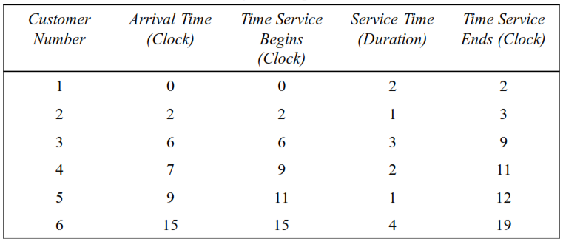
Example
Single-channel queue serves customers on a first-in, first-out (FIFO) basis

Slide 12
Simulation Software
The End of Lecture 6

